Slide 1
2rd Grade
Computer Science Dept/ College of Education for Pure Sciences
Special Topics: Microprocessor & Assembly Language
lecture3
Instructor: Ghazwan Abdulnabi Al-Ali
University of Basrah, Iraq

Slide 2
Arrays in assembly
As we know that array is sequence of elements that stored in consecutive locations can be accessed and processed sequentia1Iy, the elements can be accessed using the index, an example of an array that consists of 5 elements in C++ language is given in the fo1Iowing code:
Int a[5];
For (i=l; i<=n; i++)
Cin >> a[i];
In assembly language the thing is the same where the array elements are stored in consecutive locations in a segment of memory starting from a particular address ( offset) where the DS register refers to the address of that segment and SI register is used as index to access the elements of the array.
Note:

Slide 3
Example// write an assembly program to find the sum of an array consists of 5, elements
C++ | Assembly Language
Int a[5]; Sum=0 For(i=0;i<5;i++) Sum=sum+a[i] | MOV SI, 100 MOV ah,0 L1: ADD ah, [SI] INC SI CMP SI, 104 JLE L1
C++ | Assembly Language
Int a[5]={2,5,1,6,7} Sum=0 For(i=0;i<5;i++) Sum=sum+a[i] | ORG 100H JMP start a db 2,5,1,6,7 start: lea SI,a MOV ah,0 Mov cl,0 L1: ADD ah, [SI] INC SI INC cl CMP cl, 5 JL L1
origin
Load effective address

Slide 4
Example
  write an assembly program to create array b from array a=[3,A,6,0,7,10] where that b=a+1.

Slide 5
Solution
  ORG 100H
  JMP start
  a db 3,10,6,0,7,12
  b db ?,?,?,?,?,?
  Start: lea SI,a
  lea DI,b
  mov cl,0
  L1:MOV ah,[SI]
  ADD ah, 1
  mov [DI],ah
  INC SI
  INC DI
  INC cl
  CMP cl, 6
  JL L1
  Ret

Slide 6
Multiplication A
A- Byte X Byte
The first number put in AL register
The second number put in another Register
After the execution of MUL instruction the result will be in AX Register.
  Example/.
  MOV AL,5
  MOV BL,7
  MUL BL
After the execution of these instructions the result will be
AX= 0023h(35)

Slide 7
Multiplication B
B- Word X Word
The first number put in AX register
The second number put in another Register
After the execution of MUL instruction the result ( 4 bytes)
will be in AX & DX Registers ( DX contains the higher part of the result and AX contains the lower part of. The result).
  Example/
  MOV AX,1234
  MOV BX,2
  MUL BX
After the execution of these instructions the result will be AX & DX
DX=0000 AX=2468
Note/ can’t Multiply the register by a number; it should be a register or a memory location.
Example/
  MOV AX , 9
  mul 2 ;wronging

Slide 8
Division
Dividing Word (2 bytes) on byte
The first number ( dividend) put in AX
The second number ( divisor) ( I byte) in another .register
The result will be in AL register and the reminder in AH register
  Example/
  MOV AX , 9
  MOV BL,2
  DIV BL
After the execution of these instructions the result in AL=4 and the reminder in AH=l (AX=0l04).
Note/ can't divide the register on a number; it should be a register or a memory location.
Example/
  MOV AX , 9
  DIV 2 ;wronging

Slide 9
Example
Write an assembly program to calculate factorial x.

Slide 10
Solution:
C++ | Assembly
fa=1 For(i=2,i<=5,i++) fa=fa*i | Mov bl,5 Mov al,1 mov cl,2 Rep1: Mul cl Inc cl Cmp cl,bl Jle Rep1

Slide 11
Example
Write a program to checking x is prime.

Slide 12
Solution:
C++ | Assembly
Int f=0 Int x=5 For(i=2,i<n,i++) If(x%i==0) f=1 | mov ch,0 mov bl,4 mov cl,2 rep1: mov al,bl mov ah,0 div cl cmp ah,0 jne f1 mov ch,1 f1: inc cl cmp cl,bl jl rep1

Slide 13
Example
Assume have two arrays (a and b). Find a = a + b.
Notes:
Note/ Can't move number to memory location
Mov Reg ,[si]
Mov [di],Reg

Slide 14
Solution:
C++ | Assembly
Int a[5]={3,10,6,0,7} Int b[5]={2,4,1,8,1} For(i=0,i<5,i++) a[i]=a[i]+b[i] | ORG 100H JMP start a db 3,10,6,0,7 b db 2,4,1,8,1 start: lea si , a lea di ,b mov cl,0 rep1: mov bl,[si] mov bh,[di] add bl,bh mov [si],bl inc si inc di inc cl cmp cl,5 jl rep1

Slide 15
Example
Write an assembly program to calculate the sum of the even numbers in the array.

Slide 16
Solution:
C++ | Assembly
Int a[5]={3,10,6,0,7,12} Sum=0 For(i=0,i<6,i++) { if(a[i]%2==0) sum=sum+a[i] } | ORG 100H JMP start a db 3,10,6,0,7,12 start: lea si , a mov bh,0 mov cl,0 mov bl,2 rep1: Mov ah,0 mov al,[si] div bl cmp ah ,0 jne if1 add bh,[si] if1: inc cl inc si cmp cl,6 jl rep1

Slide 17
Example
Write an assembly program to find the sum of numbers greater than X in the array.

Slide 18
Example
Write an assembly program to generate array B from A, where B: the numbers greater than X in the array A.

Slide 19
Solution:
C++ | Assembly
a[5]={2,4,7,11,3} b[5] j=0 For(i=0,i<5,i++) If(a[i]<7) { b[j]=a[i] J++ } | ORG 100H JMP start a db 3,10,6,2,7 b db ?,?,?,?,? start: lea si , a lea di ,b Mov cl,0 Rep1: Cmp [si],7 Jge if1 Mov bl,[si] Mov [di],bl Inc di if1: inc cl Inc si Cmp cl,5 Jl rep1
Note/ Can't move number to memory location
Mov Reg ,[si]
Mov [di],Reg

Slide 20
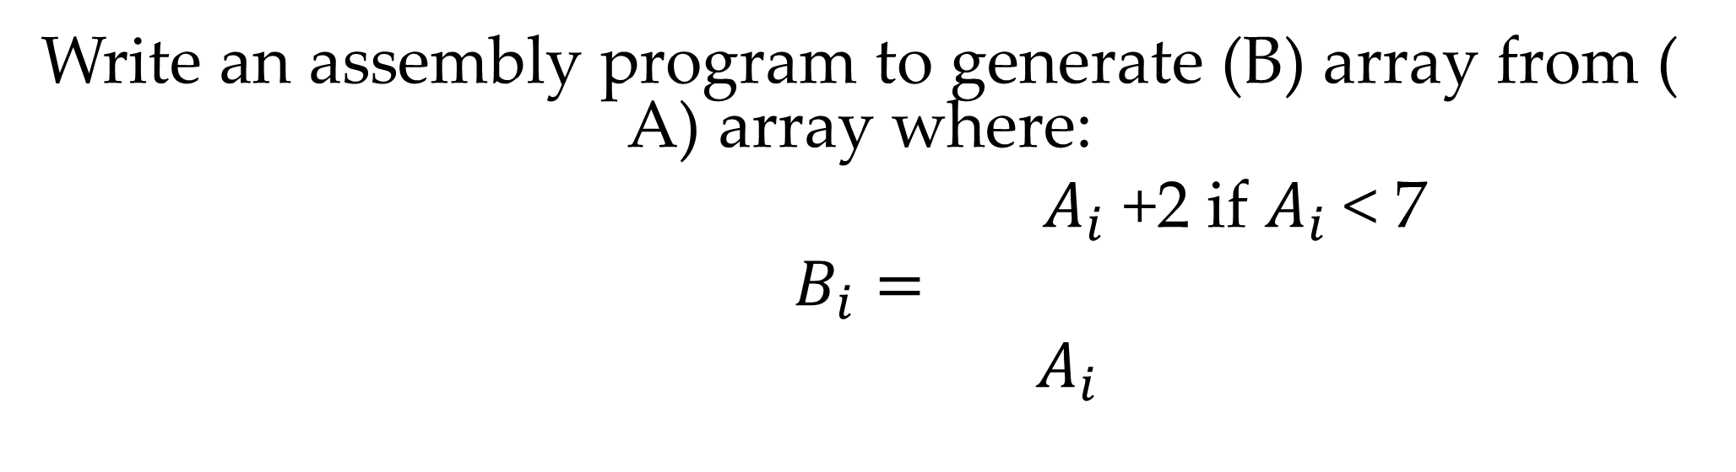
H.W 1
Write an assembly program to generate (B) array from ( A) array where:
$A_{i}$ +2 if $A_{i}$< 7
$$B_{i}=$$
$A_{i}$

Slide 21
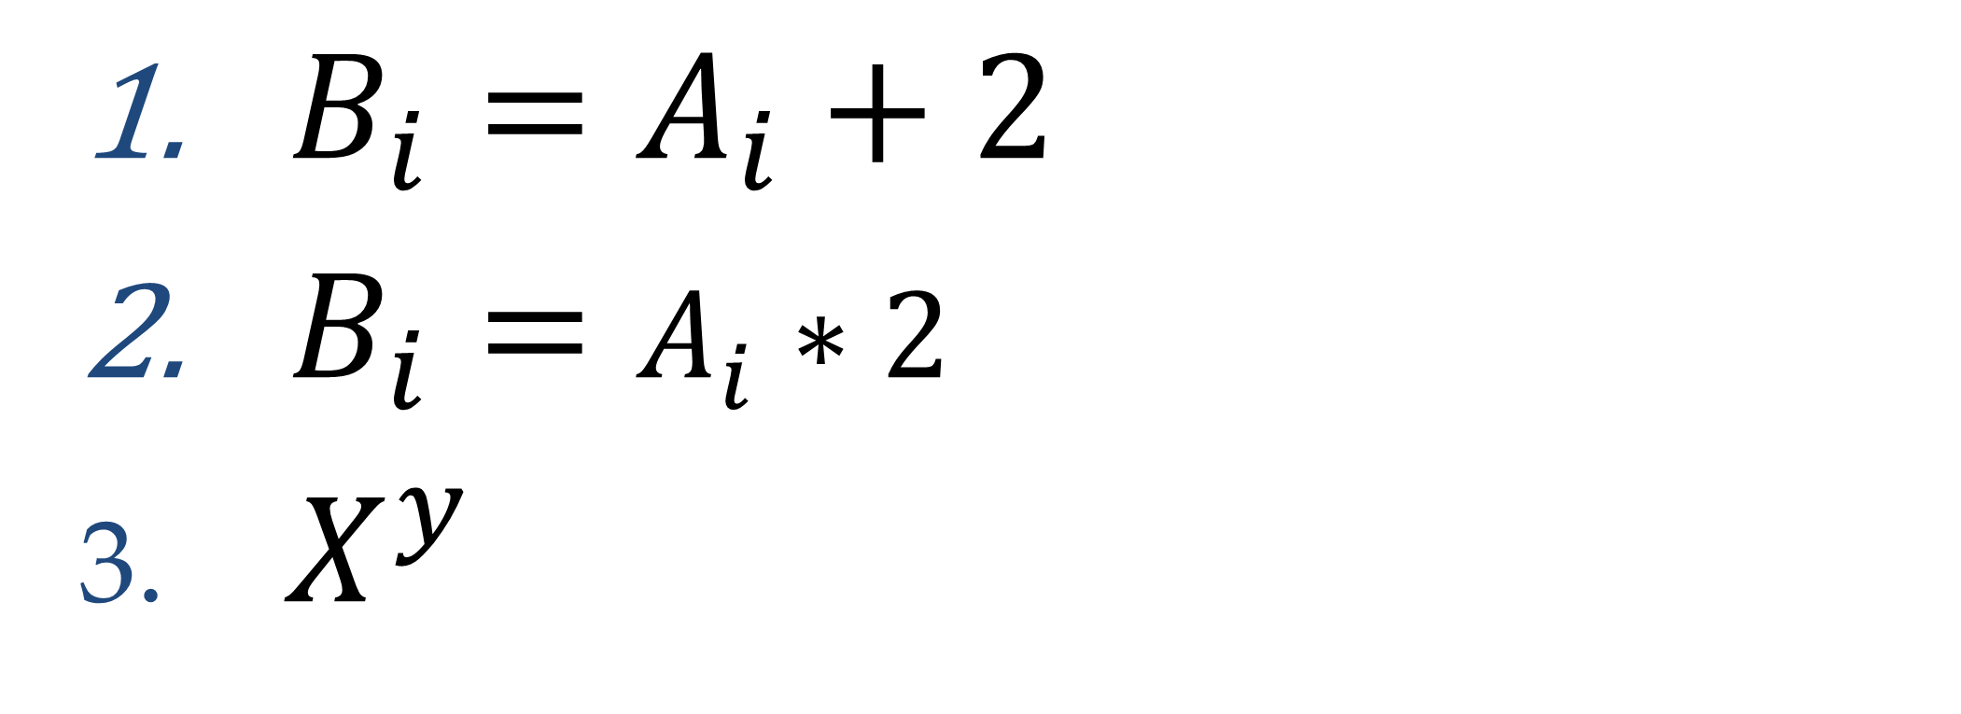
H.W 2
$B_{i}=A_{i}+2$
$B_{i}=A_{i}∗2$
$X^{y}$

Slide 22
Thank You

